Slide 1
CHAPTER 4. TESTCASE DESIGN & IMPLEMENTATION
Software Testing

Slide 2
Contents
1
Test Plan
2
Test procedure
3
Test scenario
4
Test case
5
Test execution

Slide 3

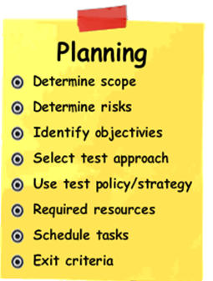
1.Test plan
Test Plan it’s a document describing the scope, approach, resources and schedule of intended test activities.
Test planning and control
Test Plan
Test analysis and design
Test implementation and execution
Evaluating exit criteria and reporting
Test closure activities

Slide 4
1.Test plan
Why do we write test plans?
  Writing a test plan guides our thinking. By using a template when writing test plans helps to organize, schedule and manage the testing effort
  The test planning process and the plan itself serve as a mean of communication with other members of the project team, testers, managers and other stakeholders.
  The test plan also helps us manage change.

Slide 5
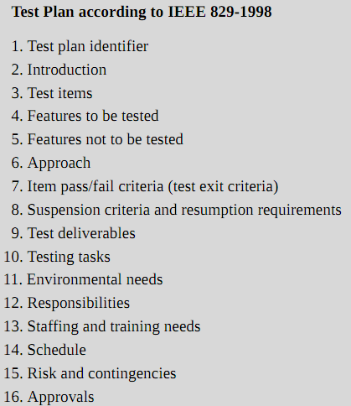
Test plan template

Slide 6
1. Test Plan
Why to identify test items/features?
  To identify what is being tested.
  To determine the overall test effort.
  Used as the basis for test coverage.
Features to be tested:
  Identify all the software features and combinations of the software features that will be tested.
  Verifiable: they have an observable, measurable outcome.

Slide 7
1. Test Plan
  Features not to be tested:
    Identify all the features and significant combinations of features that will not be tested along with the reasons.
  Not to be included in this release of the Software.
  Low risk, has been used before and is considered stable.
  Will be tested by the client

Slide 8
1. Test Plan
Test Entry and Exit Criteria
  Defining clear test entry and exit criteria is an important part of test planning.
  They define when testing can be started and stopped (totally or within a test level).

Slide 9
1. Test Plan
Entry Criteria:
  Entry criteria are used to determine when a given test activity can start. This could include the planning, when test design and/or when test execution for each level of testing is ready to start.
  Examples:
    Test environment available and ready for use (it functions).
    Test tools installed in the environment are ready for use.
    Testable code is available.
    All test data is available and correct.
    All test design activity has completed.
  These criteria are preconditions for starting test execution. They prevent the test team from wasting time trying to run tests that are not ready.

Slide 10
1. Test Plan
Exit Criteria:
  Exit criteria are used to determine when a given test activity has been completed or when it should stop. Exit criteria can be defined for all of the test activities, such as planning, specification and execution as a whole, or to a specific test level for test specification as well as execution.
  Examples:
    All tests planned have been run.
    A certain level of requirements coverage has been achieved
    No high-priority or severe defects are left outstanding.
    All high-risk areas have been fully tested, with only minor residual risks left outstanding
    Cost – when the budget has been spent
    The schedule has been achieved

Slide 11
2. Test procedure
Test procedure is document providing detailed instructions for preconditions for a test, data inputs necessary for the test, actions to be taken, expected results, and verification methods
A Test Procedure could be testing of a system, a service, a function, an interface, or a component
Each Test Procedure are 1 or more Test Scenarios
Test Procedure 1
Test Procedure 2
Test Scenario 1
Test Scenario 2.1
Test Scenario 2.2
Test Scenario 2.3

Slide 12
3. Test Scenario
Test scenario (like a high-level test case):
  It is also known as Test Suite or less commonly Validation Suite.
  A test scenario is a collection of test cases that are intended to be used to test a software program
  Purpose is to show that it has some specified set of behaviors.
  It often contains detailed instructions or goals for each collection of test cases and information on the system configuration to be used during testing.

Slide 13
3. Test Scenario
Test Scenario provides one-line information about what to test.
Each Test Scenario are 1 or more Test Cases
Example:
Test Scenario 2
Test Scenario 1
Test Case 2.1
Test Case 2.2
Test Case 2.3
Test Case 1
Test Scenario | Test Case
User receives an error message when he enters invalid parameters in the login page | TC 1: User receives an error message when he enters valid user_id and invalid password.
 | TC 2: User receives an error message when he enters invalid user_id and valid password
 | TC 3: User receives an error message when he enters invalid user_id and invalid password

Slide 14
4. Test case
Test case:
  is a set of input values, execution preconditions, expected results and execution post conditions, developed for a particular objective or test condition, such as to exercise a particular program path or to verify compliance with a specific requirement.
  Test Case is like a check list to make sure that all the requirements are covered in the testing
Test case vs Test scenario
Test scenario: “What to be tested”
Test case is: “How to be tested”

Slide 15
4. Test case
Test Cases are derived from Test Scenarios that are identified in a Test Procedure
Test Procedure
Test Scenario 1
Test Scenario 2
Test Case 1.1
Test Case 1.2
Test Case 1.2
Test Case 2.1

Slide 16
4. Test case
The key purpose of a test case is to ensure if different features within an application are working as expected. It helps tester, validate if the software is free of defects and if it is working as per the expectations of the end users.
Other benefits of test cases include:
  Test cases ensure good test coverage
  Help improve the quality of software
  Decreases the maintenance and software support costs
  Help verify that the software meets the end user requirements
  Allows the tester to think thoroughly and approach the tests from as many angles as possible
  Test cases are reusable for the future – anyone can reference them and execute the test.

Slide 17







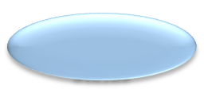




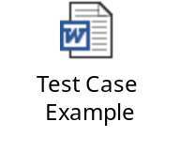



4.1 Test Case Structure
Test Case Name / Summary
Description / Objective
Test Case ID
Priority
Actual Result
Test Case Type
Test Case Structure
Execution Result / Status
Automation Status
Attachment
Pre-condition
Test Inputs / Test Data
Test Steps
Expected Result
* Test Case structure might vary depending on particular project needs.

Slide 18
4.2 Test Case Structure
Test case ID:
  Identification of the test case
  It should be unique across Test Case Specification
  Can consist of numbers or/and letters
  Example: 1, 2, 3, etc; UR.001, UR.002, etc
Test Case Name:
  Short name of test case which briefly indicates what will be verified
Objective:
  Describes the functionality/actions that test case validates/does
  It should be detailed enough to understand purpose of test case
Test Case Type/Specification Areas
  Reflects the type of test case depending on what kind of testing is covered by particular test case
  Example: GUI, Functional, System, Performance, etc.

Slide 19
4.2 Test Case Structure
Pre-Condition (optional):
  Defines conditions that should be met before test case can be executed
  Usually pre-condition field lists data/actions which should exist/be done in system and links to appropriate test cases/test functions which can setup required pre-conditions
Test Data/Test Inputs
  Lists data which is used while test case execution
  Can be presented in this field directly or via link to attached files
  Data should be accurate!
Attachment
  May contain files which can be used while test case execution

Slide 20
4.2 Test Case Structure
Priority
  Reflects the relative importance of the test case taking into consideration different aspects
  Can be presented by words or numbers
  Example: High, Medium, Low, etc;
Major, Minor, Trivial, etc;
1, 2, 3 (where 1-the most important, and 3-the least important), etc
Automation Status
  Indicates whether test cases is candidate for automation taking into consideration different aspects or not
  Also indicates whether test cases is automated already or not
  Example:
    Candidate – test case is recommended for automation, but it is not automated yet
    Not Candidate – test case is not recommended to be automated and should be run manually
    Automated – test case is automated and during the next execution can be run automatically etc.

Slide 21
4.2 Test Case Structure
Actual Result
  Shows the actual output of the system. This field is used when actual behavior of the system doesn’t meet expected results of test case
Expected Results:
  Shows how the system must react based on the test steps
  Expected results should be mentioned only for test case objective!
  “Verify”, “Correctly”, “Successfully” words are for bidden for expected results! Exact behavior of the system, which is going be verified, should be mentioned
  Example:
Incorrect: Verify “TestUser” user is created
-> It is not understandable how to verify it
Correct: “TestUser” user appears in the list of users

Slide 22
4.2 Test Case Structure
Execution Result / Status
  Shows the result of test case execution to indicate whether behavior of the system meets expected results of test case or not
  Example:
  Pass – expected results of test case and behavior of the system match
  Fail – expected results of test case and behavior of the system do not match
  Blocked – test case was unable to be executed due to some reasons (e.g. blocker issue, etc)
  Skipped – test case was untested since it wasn’t planned to be executed this time, etc.

Slide 23
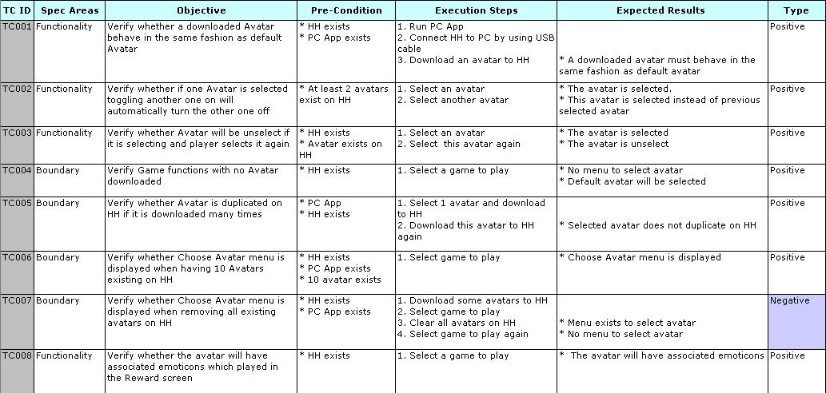
4.2 Test Case Structure - Example

Slide 24
4.3 Test Case: Priority
Software testers may prioritize their test cases in order:
  to reduce the cost of regression testing, so that those which are more important, by some measure (e.g. if the time limits means…), are run earlier in the regression testing process
  to increase a test suite's rate of fault detection, thus allowing developers to fix severe faults earlier in software development process
Prioritizing test cases can be done by considering:
  high critical functionalities, which are the parts of Core test cases or new functionality, implemented in build/release
  modules containing more bugs, more complex or more dependent areas which are highly accessed by the customer/end users
  positive test cases
  risk analysis

Slide 25
4.4 Test Case: Automation Status
Good Candidates for Automation are:
  Repetitive test cases that run for multiple builds
  Test cases that run on several different configurations (hardware/OS)
  Frequently used functionality that introduces high risk conditions
  Test cases that tend to cause human error
  Test cases that require multiple data sets
  Test cases that are impossible to perform manually
  Test cases that take a lot of effort and time when manual testing

Slide 26
4.4 Test Case: Automation Status
Bad Candidates for Automation are:
  If automation efforts are few times higher than manual execution
  Test cases that are only performed a few times
  Some test steps cannot be automated

Slide 27
4.5 Type of test case
There are 3 main categories:
  Positive or “happy path” test case
  Negative test case
  Combination test case
Test Case Types comes under these categories:
  Functional Test Cases
  Performance Test Cases
  Security Test Cases
  Integration Test Cases
  Database Test Cases
  Usability Test Cases
  Acceptance Test Cases

Slide 28


4.5 Type of test case
Positive test case: The most obvious set are Positive or “happy path” test cases. These test cases are designed to return what are expected according to the requirement
Negative test case: The test is designed to test the robustness of the software and the system to unexpected or varying inputs, states, or conditions.
Combination test case: The test is designed to determine whether the response of the product is still expected when doing a series of tests that follow each other

Slide 29
4.6 Test case development
How to analyze Requirement
How to design Test Case ID
How to analyze Objective
How to create Steps
How to analyze Expected Result

Slide 30
4.6 Test case development
1. How to analyze Requirement
  Read documentation carefully to understand system, application or function
  Pick out sentences that describing specifications from a system, application or function in technical document of project
  2. How to design Test Case ID
  Test Case ID must be unique in test case suite
  Test Case ID should be involved the abbreviation of specification area and figures
  Example:
    Test cases ID relate to Tutorials should be TUT001, TUT002,…
    Test cases ID relate to Power Management should be PM001, PM002,…

Slide 31
4.6 Test case development
3. How to analyze Objective (test case)
Each requirement can have one or more cases to verify. These cases can be in 3 groups:
  Positive case
  Negative case
  Combination case

Slide 32
4.6 Test case development
3. How to analyze Objective (test case)
  Positive Case:
    Create positive cases by following right instruction of requirements to verify expectation of system, application, function,…
    Each requirement have at least a positive test case

Slide 33
4.6 Test case development
3. How to analyze Objective (test case)
  Negative Case:
    Create negative cases by deliberately entering bad data or using other techniques to try to break the functionality.
    Top 10 negative test cases should consider when designing test effort
      Embedded Single Quote - Most SQL based database systems have issues when users store information that contain single quotes
      Required Data Entry - Write test cases to ensure it forces you to enter data in the field
      3.Field Type Test - Write test cases to ensure it forces you to enter data in the correct format based on the field type
      Field Size Test - Write test cases to ensure that you can only enter the specified number of characters
      Numeric Bounds Test - For numeric fields, it is important to test for lower and upper bounds

Slide 34
4.6 Test case development
3. How to analyze Objective (test case)
  Negative Case:
      Numeric Limits Test - Write test cases to ensure that it does not get an numeric overflow error.
      7. Date Bounds Test - Write test cases to test for lower and upper bounds of date
      8. Date Validity - Write test cases to ensure that invalid dates are not allowed and test cases should also check for leap years
      Web Session Testing - Many web applications rely on the browser session to keep track of the person logged in, settings for the application, etc. Create test cases to launch web pages within the application without first logging in
      10. Performance Changes - should include test cases that compare the prior release performance statistics to the current release. This can aid in identifying potential performance problems

Slide 35

4.6 Test case development
3. How to analyze Objective (test case)
  Combination Case:
    Think about complex test scenarios that can affect to a system, functions,…
    Complex test scenarios are aggregated use cases that combine one or more of the user functions and conditions to create practical usage scenarios
    Ex: an HR manager will log on to the system, check existing employees, add a new employee, verify the addition, and then log out of the system
    Combination test cases are derived complex test scenarios
What’s happen if I do … while …?
What’s happen if I do like this, next I do… and then I do…?

Slide 36
4.6 Test case development
How to create Steps
Upon objectives of test case we can design 2 types of Steps:
  Detailed steps:
    Often apply for atomic or small test cases
    Steps are described detailed and queued up
    Steps must relate to objective of test case and clearly
  Main steps:
    Often apply for combination or general test cases
    Steps are described in general (show up main steps or important steps only)
    Steps must relate to objective of test case and clearly

Slide 37
4.6 Test case development
How to analyse Expected Result
  Expected result must describe what you expect the function or system to do
  Expected result is corresponding to the step that caused
  Expected result must be clearly and relate to the Objective of the test case
Step 1
Step 2
Objective
Step 3
Step N
Expected Result

Slide 38
4.6 Test case development
Test case development:
  Boundary testing
  Equivalence classes
  Decision tables
  State transition diagrams
  Risk Analysis

Slide 39
5. Test case implementation - Flow
Requirement
Any statement describing a functionality that is expected of the system
Test Scenario
Any condition that could possibly happen in production
Test Case
Pre-conditions + Input -> Output + Post Conditions
Test Set
A group of similar test cases that require the same steps to be executed
Test Script
A set of steps, manual or automated, to execute a set of similar test cases

Slide 40
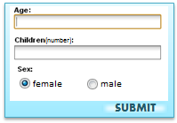
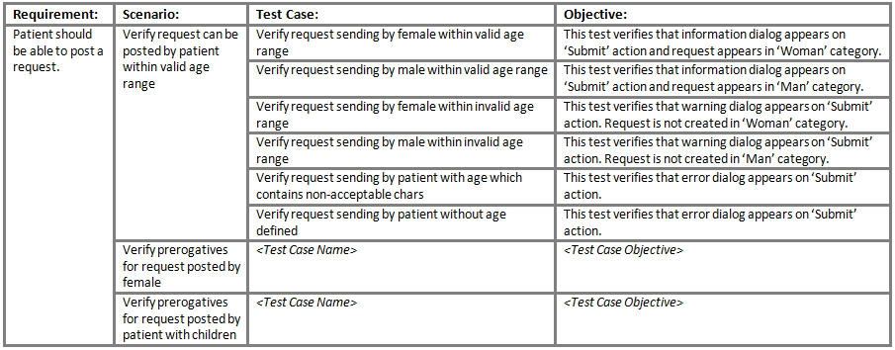
5. Test case implementation - example
Requirement :
18-55 patient should be able to post a request, which should be processed within 1 hour. If patient is 45-55 female with more then 1 child – request should be processed within 30 minutes.
Test Design

Slide 41
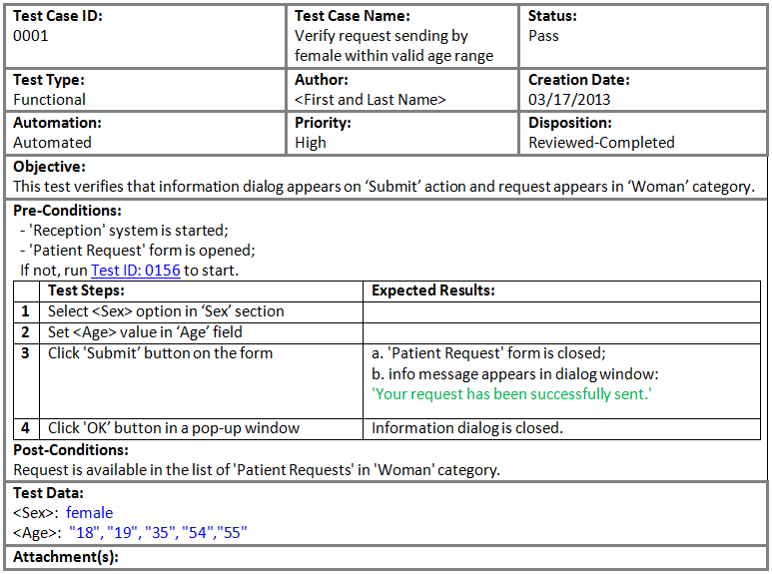

5. Test case implementation - example
Test Case

Slide 42
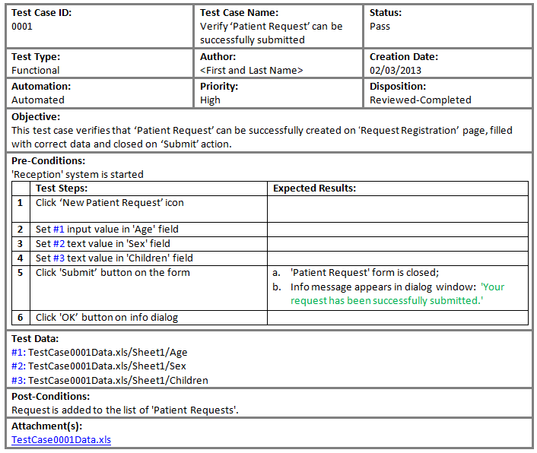
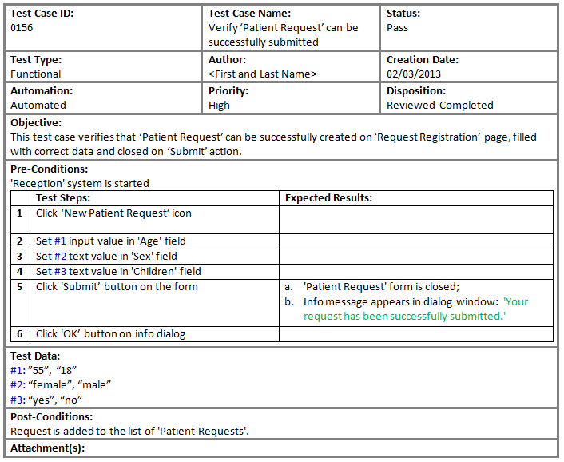
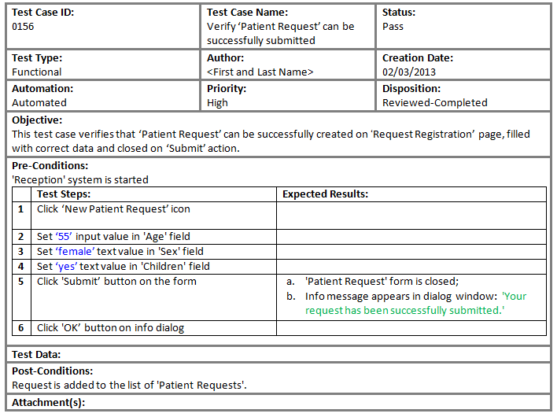
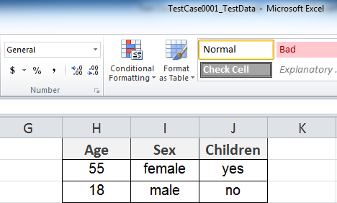
Test case implementation - Test Data Preparation
Test Data Representation
In Test Steps
In Test Data section
In Attachment
Pros
suitable to use when test case is a candidate for automation.
Pros
easy to maintain;
one test case can be executed with different data and you do not need to duplicate test cases.
Pros
easy to maintain data;
data in separate document are better structured.
Cons
not suitable for manual testing (each time test case executes the same input values);
- hard to maintain.
Cons
test data field is not readable in case of a lot of data or long values.
Cons
opening separate file for each test case is time consuming.

Slide 43
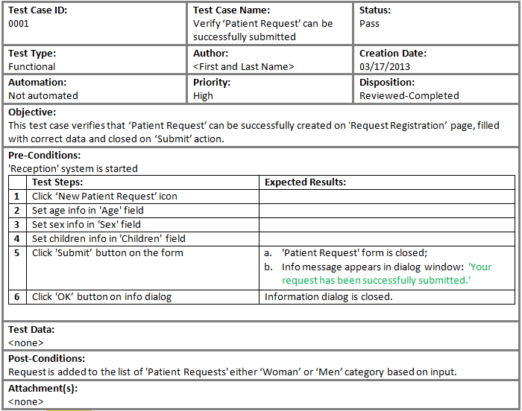
5. Test case implementation - Test Data Preparation
Test Data on Tester’s disposal ☺
Pros
time saving during test cases designing;
time saving for experienced tester in specific area during test cases execution (not always, since some test cases require complex inputs, queries, etc.);
important bugs can be found.
Cons
time consuming for non-experienced tester in specific area during test cases execution;
hard to entail issue due to chaotic inputs.

Slide 44
5. Test Case implementation- Result Tracking
Update Test Case
Execute Test Case

Slide 45
5. Test Case Result Tracking – Update TC
Update test cases: When the game design or the documentations are changed, you must update the test case suite base on the newest documentations or base on the game design on current build if the client request:
  Add new test cases
    If you find new cases can apply to test, please add these cases as new test cases into test case suite
  Edit test cases to match the newest requirements
    If the Steps (or Specification Area) to run test case has been changed in the newest documentations, the test case has to also update the Steps Execution (or Specification Area) again
  Delete test cases no longer suitable
    If the requirement for feature has been changed in the newest documentations, the test case relate to that requirement has to be removed out

Slide 46
5. Test Case Result Tracking –Execute TC
Execute Test Case: Execute test cases to get result of testing
  Read Objective of test case carefully to understand what will be verified here
  Read Pre-Condition to prepare the need stuffs in advance (The stuffs really need to execute test case)
  Execute application (game, web application,…) by following step by step in Execution Steps of test case
  Compare observed result with expected result of test case
  Update result of test case into:
    Status column
    Bug ID column

Slide 47
5. Test Case Result Tracking –Execute TC
Execute Test Case (cont)
  Update Status of test case
    If observed result matches the expected result:
      Set “Pass” to Status column for the test case
    If observed result does not match the expected result:
      Set “Fail” to Status column for the test case
    If there is a reason that prevent you from executing the test case (cannot do a step, function is not implemented, a bug blocks testing the test case,…):
      Set “Pending” to Status column for the test case
      Note the reason why the test case is pending

Slide 48
5. Test Case Result Tracking –Execute TC
Execute Test Case (cont)
  Update Bug ID for test case
    If observed result matches the expected result:
      Bug ID for the test case must be removed out of “Bug ID” column if it has been noted already before
    If observed result does not match the expected result:
      Submit a bug to bug database and note the bug ID of submitted bug into “Bug ID” column if it has not noted yet before
Failed Test Case
Bug ID

Slide 49
Thank You !

